Slide 1
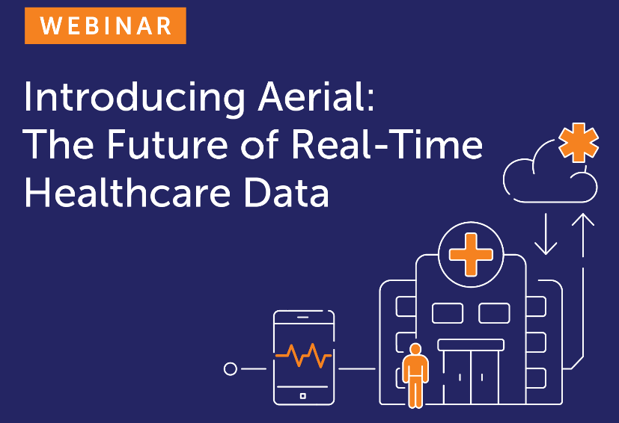
WEBINAR | JUNE 25, 2004

Slide 2
It’s time to make your data make a difference.
\
Proven value delivered to 35 million lives
INTRODUCING THE AERIAL DATA PLATFORM AND CLINICAL INTELLIGENCE ENGINE
Improved Health Outcomes: over 35% completion of goals and behaviors changed
Optimized Medical Costs: 15% reduction in ER visits
Reduced Administrative Costs: Decreased implementation times of 4x and increase clinical staff efficiency by 50%
Personalized Engagement: Increased engagement by 30% through multi-channels
Ingests and transforms all types of data sources
Advanced analytics and AI to rapidly extract insights from data
Campaign orchestration, workflow and reporting tools improve efficiency and impact of clinical workflows and drive personalized member engagement
API platform and consulting support enables customers to develop proprietary capabilities that leverage the Medecision platform
How it Works
Medecision’s cloud-based, data-powered platform enables risk-bearing entities to achieve improved health outcomes, reduced medical and administrative costs, and personalized engagement.
© 2024 MEDECISION, INC. PROPRIETARY AND CONFIDENTIAL
2

Slide 3
A flexible, scalable, data platform to support multiple use cases
Health Data & Analytics Platform
INGESTION
TRANSFORMATION
Customer to FHIR pipeline
Real-time intelligence pipeline
Individual matching algorithm
Data enrichment pipeline
Healthcare summary pipeline
INTELLIGENCE ENGINE
Real-time rules builder
Population builder
Program builder
Campaign builder
Template builder
Journey Builder
EXTERNAL REAL-TIME FEEDS
Patient 360
DATA LAKE
DATA PRODUCTS
Healthcare API/FHIR Store
Analytics datasets
Real-time dashboards
Individual records
EXTERNAL DATA SOURCES
Streaming Data
Batch Files
Data Warehouse
Timely interventions and next best actions
Proactive care using predictive analytics
ANALYTICAL ZONE
Personalized care plans to each individual’s unique profile
Positive behavioral change with enhanced engagement
DATA PLATFORM OPERATIONS
Data Catalog
Pipeline Monitoring
Data Quality
Data Security
Data Orchestration
Data Infrastructure
© 2024 Medecision, Inc. Proprietary and Confidential
3

Slide 4
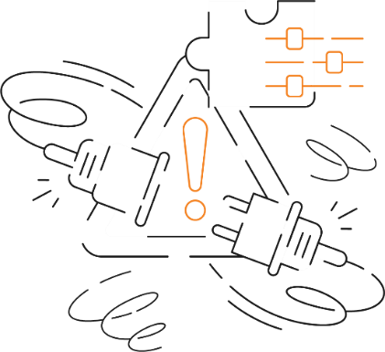
Challenges
The Drive to Full Contextual Awareness and Personalization
Real-time and Flexible Data Ingestion and Integration
[The toughest nut to crack]
Lack of Built-in Care Intelligence
[It’s like a body without a central nervous system]
Stuck in the Past
[The real tragedy of no real-time data access]
Disconnected Healthcare
[Failure to integrate all clinical data sources in real-time]

Slide 5
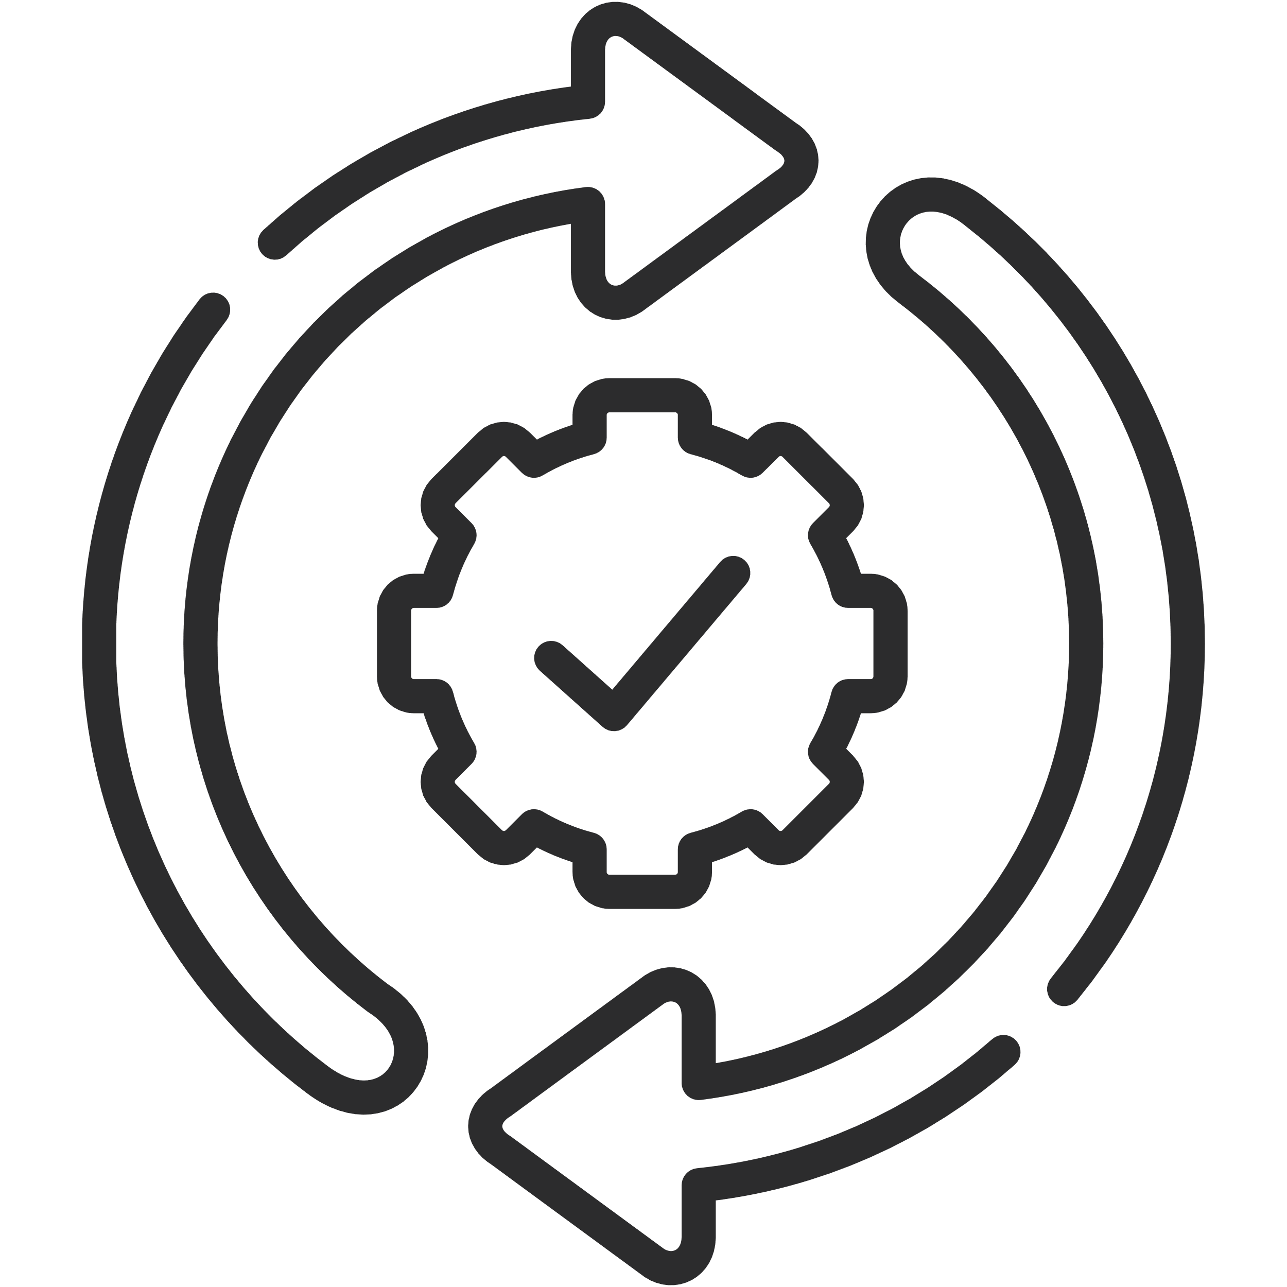
© 2024 MEDECISION, INC. PROPRIETARY AND CONFIDENTIAL
USE CASE: REAL-TIME ADT
Powering member engagement, improving outcomes, reducing costs
Reduced medical costs estimated for emergency room and inpatient visits
For example, payer is using ADT data to identify members for care coordination and management.
64% of members engaged successfully enrolled in a mental health program / have accepted referrals to behavioral health resources
Average time between trigger/enrollment/education for 74% of members was less than 3 days
Care managers attribute success to timing of outreach, (immediately following ED visit) ensuring swift intervention and support for individuals in need
Members expressed enhanced satisfaction with timely and personalized support, contributing to more positive overall healthcare experience
Aerial Connect Emails / Text Member
ADT Feed
Aerial Data Platform
Aerial Clinical Intelligence Engine
Task Created in Aerial CM

Slide 6
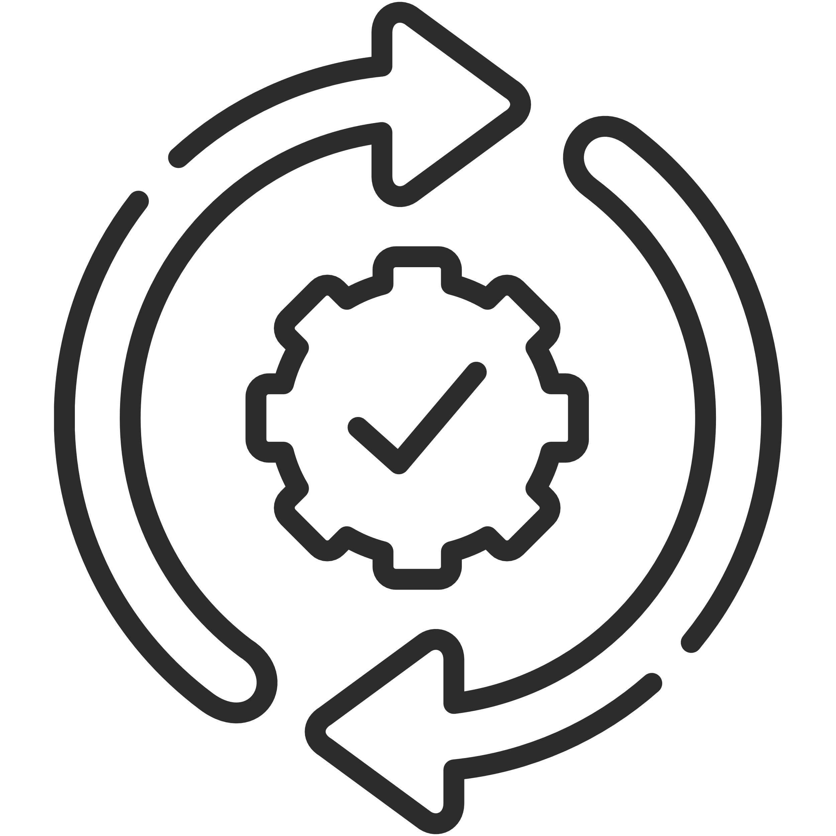
USE CASE: VALUE-BASED CARE
Improving health plan and provider coordination to boost STAR measures
Why?
Average Medicare Advantage Plan costs $645 PMPM. Maintaining a minimum of 4 stars ensures a 5% bonus, amounting to $12.4 million for 32,000 members.
Additionally, transitioning care services can significantly reduce post-discharge healthcare costs while improving clinical outcomes, such as lowering mortality and readmission rates.
How?
By coordinating closely between health plans and providers. Utilizing near real-time ADT data helps to promptly identify high-risk members who have recently visited the emergency department (ED).
This swift identification allows for immediate communication between care managers and the member’s PCP, significantly increasing the likelihood of a follow-up visit to their PCP within 7 days after an ED visit.
T A R G E T
Improve Current 2 STAR Rating for Part C Measure:
“Follow-up After ED Visit for People with Multiple High-Risk Chronic Conditions”
ADTs
Care Manager Notification
Alerts
ADT Summary
Aerial Data Platform
Aerial Clinical Intelligence Engine
PCP Assignment Options
Fax
Members and Providers
PCP Notification
Direct Message to Secure Inbox

Slide 7
© 2024 MEDECISION, INC. PROPRIETARY AND CONFIDENTIAL
7
Questions?
Request a Demo
www.medecision.com

Slide 8
Medecision Proprietary and Confidential Information
Copyright © 2024 by Medecision, Inc. All rights reserved. No parts of this document may be reproduced, transmitted, or stored electronically without Medecision’s prior written permission.
This document contains Medecision’s confidential or proprietary information. By accepting this document, you agree that: (A)(1) if a pre-existing contract containing disclosure and use restrictions exists between your company and Medecision, you and your company will use this information subject to the terms of the pre-existing contract; or (2) if no such pre-existing contract exists, you and your Company agree to protect this information and not reproduce or disclose the information in any way; and (B) Medecision makes no warranties, express or implied, in this document, and Medecision shall not be liable for damages of any kind arising out of use of this document.

